Slide 1
Industry Onboarding and Transition
Industry Onboarding Team

Slide 2
Agenda
NBIS system notifications and communication efforts
NBIS Industry Training
Help Resources
Q and A

Slide 3
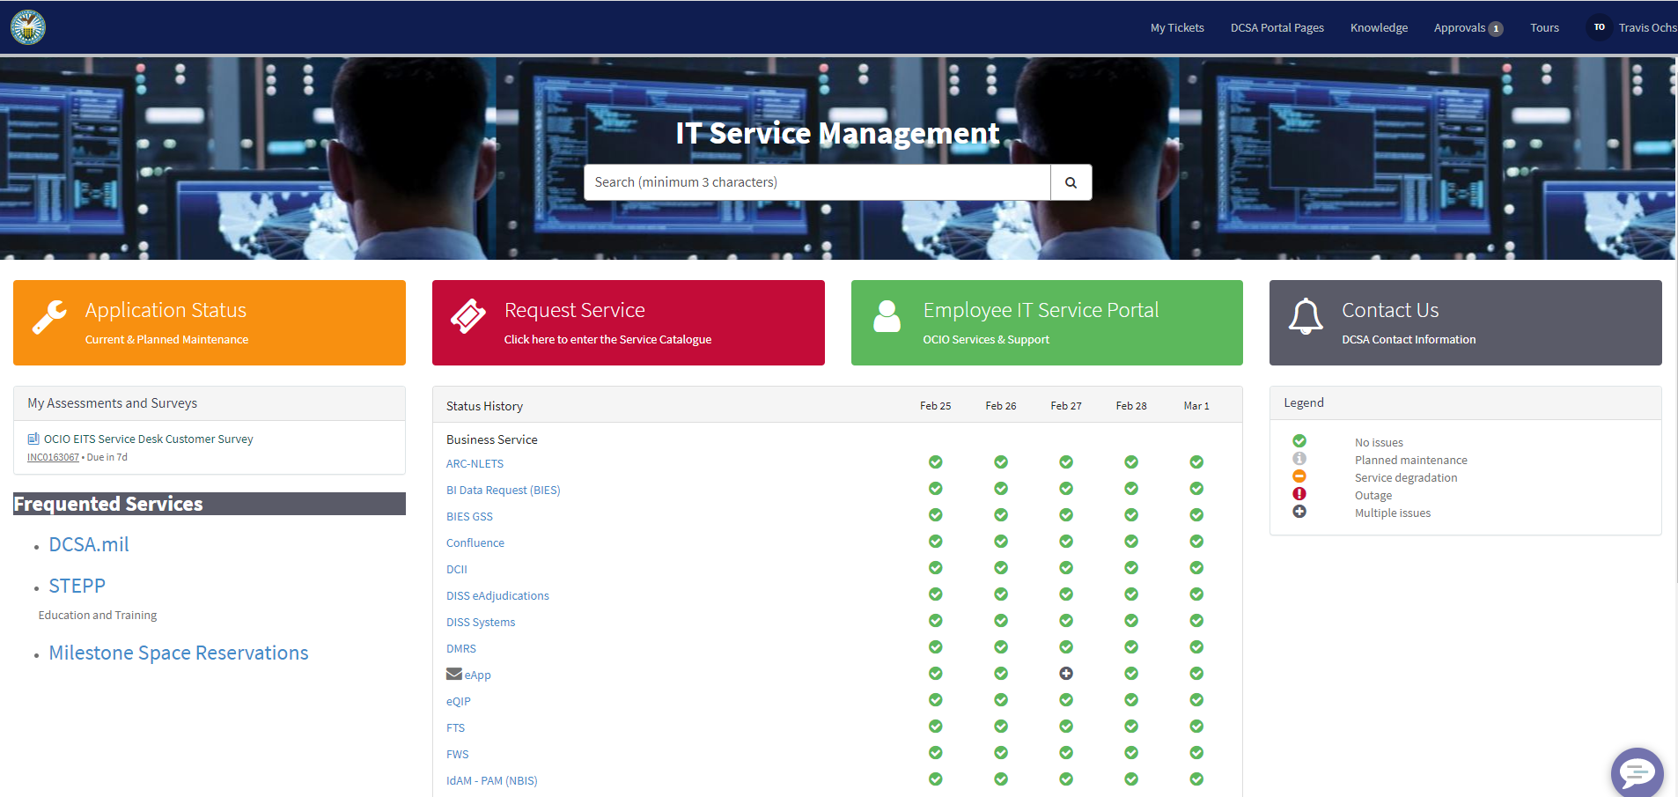
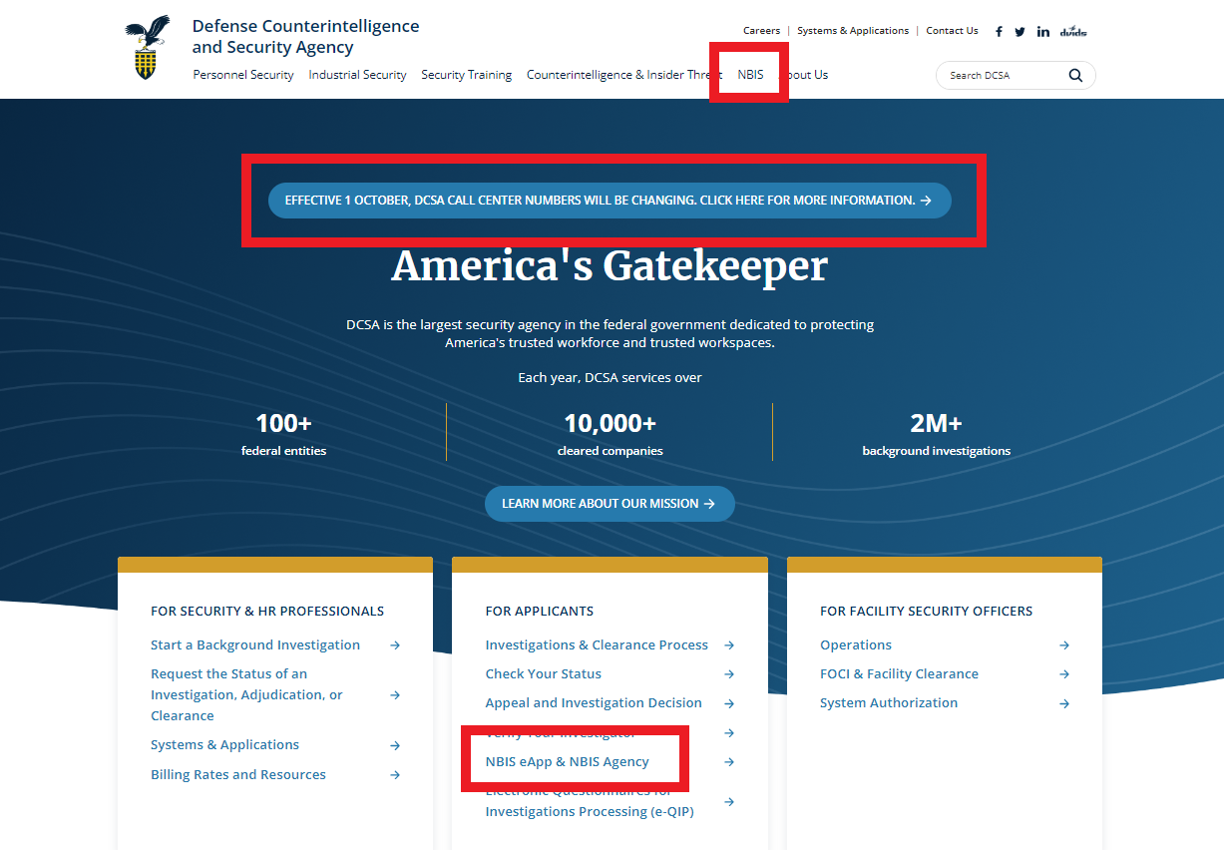
NBIS System Support, Notifications and Communication
ESD/ServiceNow (DCSA ServiceNow CSM)
Enhanced Communication on www.DCSA.mil
https://esd.dcsa.mil/csm
Platform for NBIS user support to include:
  Help Desk (Submit tickets)
  System Notification (Displayed at the top of the homepage)
  System Statuses (Including NBIS and eApp)
System Notification messages are being blasted to all NBIS users at this time.
  Messages include important information on system outages, updates and functionality.
  NBIS Notification listing is updated weekly.
DCSA Office of Communications & Congressional Affairs (OCCA) has expanded NBIS information our site
A permanent “NBIS” tab has been added to the top menu. The tab includes sub-menus for NBIS and Industry onboarding
A banner notice has been added to the homepage with new phone numbers at the Boyers processing center
Link for eApp and NBIS Agency that takes the user to the landing page to log into both applications.
The News and Publications section includes a 9/27 promotional message from NISPPAC on the importance of NBIS.
More information to follow in 2024.

Slide 4
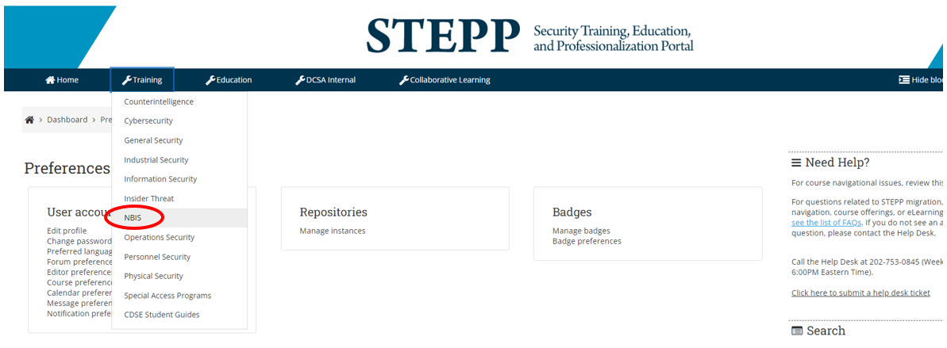
NBIS Industry Training
Contact:
  For access or other issues, contact dcsa.quantico.nbis.mbx.training@mail.mil
Recorded Webinars are available now on STEPP.
Live Initiate Review (IR) Webinars happening weekly through the remainder of the fiscal year.
  Sign-up in STEPP:
  IR Webinar Enrollment
NBIS Training is available at:
https://cdse.usalearning.gov (STEPP)
Resources currently available:
  e-Learning courses
  Job Aids & references
  Recorded NBIS demos videos
  eApp videos

Slide 5

UNCLASSIFIED
Help Resources
Support Help Desk/Customer Engagement Team (CET)
  For trouble accessing NBIS ServiceNow or experiencing issues during onboarding and/or within the NBIS system.
  Email: dcsa.ncr.nbis.mbx.contact-center@mail.mil
  Phone: 878-274-1765
Applicant Knowledge Center (AKC)
  For Industry subjects and applicants who need assistance with the completion of eApp.
  Email: dcsa.boyers.dcsa.mbx.applicant-knowledge-center@mail.mil
  Phone: 878-274-5091
NBIS ServiceNow Help Desk
  In addition to the call in number above, Industry users can alternatively submit a ticket in NBIS ServiceNow for any support needed for NBIS and/or ServiceNow.
Contact for DCSA Services to Partner Agencies
  Please visit:
  https://www.dcsa.mil/Contact-Us/Services-to-Partner-Agencies/
Notes:
Talking Points
• Depending on the need or concern, help resources are available for NBIS users.
For trouble accessing NBIS ServiceNow or experiencing issues during onboarding and/or within the NBIS system, you should contact the DCSA Customer Engagement Team (CET) using the email address or phone number shown here.
In addition to contacting CET using the email or call-in number, you can alternatively submit a ticket in NBIS ServiceNow for any support needed for NBIS and/or ServiceNow. However, we do ask that you provide enough details in their ticket to address the concern. Instructions on how to do this are also included in the User Guide that is sent to begin onboarding into NBIS.
And finally, if you have questions or feedback concerning the onboarding process, you can email our team using the designated email shown on the screen. As previously mentioned, if you are an Account or Hierarchy Manager in DISS for your facility and did not get an email notification to begin onboarding, please email our team at the email address provided here.

Slide 6
Q&A
UNCLASSIFIED

