Slide 1
Insider Threat
Creating an
Program

Slide 2
Donald Fulton
Counterintelligence Programs Manager
Facility Technology Services, Inc.

Slide 3
Insider Threat
1 August 2014 – DSS/NISPOM
Industrial Security Representatives
NISPOM Conforming Change 2 pending
????

Slide 4
Agenda
History
Key Terms
Purpose
Documents
Resources
Requirements
Recommendations

Slide 5
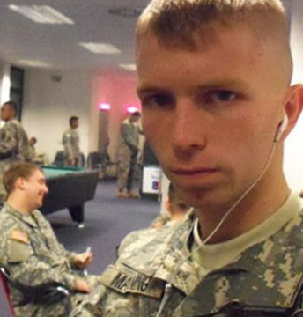
The Reason
PFC Bradley Manning
Arrested 27 May 2010
700,000 documents
Found guilty on 17 counts
Sentenced to 35 years

Slide 6
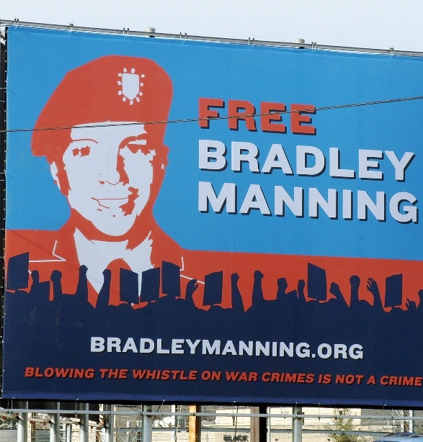
Insider Threat
Intelligence Analyst
TS/SCI eligibility
Emotional instability
Security Violations
Personal and government IT
Behavioral Problems/Assault
Poor security practices in unit

Slide 7
E.O. 13587
7 October 2011
Structural Reforms to Improve the Security of Classified Networks and the Responsible Sharing and Safeguarding of Classified Information
National Insider Threat Task Force
Shall be binding on the executive branch

Slide 8
NITTF
National Insider Threat Task Force
US Attorney General
Federal Bureau of Investigation
Director National Intelligence
National Counterintelligence Executive
Assist agencies in developing and implementing their insider threat programs,
National Insider Threat Policy

Slide 9
Policy
National Insider Threat Policy
NITTF
November 2012
Minimum Standards

Slide 10
DoD Definition
Acts of commission or omission by an insider who intentionally or unintentionally compromises or potentially compromises DoD’s ability to accomplish its mission. These acts include, but are not limited to, espionage, unauthorized disclosure of information, and any other activity resulting in the loss or degradation of departmental resources or capabilities.

Slide 11
Purpose
Deter, detect, and mitigate compromises of classified information by malicious insiders
Safeguarding classified information from exploitation, compromise, or unauthorized disclosure
Does not erode civil liberties, civil rights, or privacy protections for government employees

Slide 12
Minimum Requirements
Designate insider threat senior official
Annual Reporting
Oversight mechanism
Analytic capability
Establish reporting procedures
Fully trained Insider Threat personnel (NITTF)
Access to employee information
Network monitoring (AIS)
Employee training and awareness
Six months to implement

Slide 13
Don’t Panic
Designate Insider Threat Senior Official
Annual Reporting
Oversight mechanism
Analytic capability
Establish reporting procedures
Fully trained Insider Threat personnel (NITTF)
Access to employee information
Network monitoring (AIS)
Employee training and awareness
Six months to implement

Slide 14
Insider Threat
Reporting
Network Monitoring
Disregard for security practices
Suspicious behavior/contacts
Attempts to expand access
Financial vulnerabilities
Foreign influence of connections
Attempts to expand access
Disregard for security practices
Network misuse
Removing/downloading classified

Slide 15
Documents
EO 13587
National Insider Threat Policy and Minimum Standards
Insider Threat Senior Official Appointment Letter
Insider Threat Awareness Training
Company Insider Threat Policy
Company Insider Threat Annual Report

Slide 16
Resources
National Insider Threat Task Force
http://ncsc.gov/nittf/index.php
Center for Development of Security Excellence
http://www.cdse.edu
Defense Security Service
http://www.dss.mil/index.html

Slide 17
Senior Official
Cleared at the same level as Facility Clearance
Senior Management/KMP level
May be Facility Security Officer
Company Senior Leadership must support
Must have appropriate authority

Slide 18
Training
Within 30 days for initial
Annual refresher
Mirrors current NISPOM requirement for security training

Slide 19
Reporting
Insider Threat
Senior Official
Human Resources
Personnel Security
Physical Security
Network Monitoring
Employee Reporting
Disciplinary Action
Counterespionage Investigation
Potential Threat Activity

Slide 20
Analysis
Insider Threat Analysis
Physical Security
Human Resources
Information Technology
Legal/Law Enforcement
Counterintelligence

Slide 21
Agenda
History
Key Terms
Purpose
Documents
Resources
Requirements
Recommendations

Slide 22
Questions
Donald Fulton
Counterintelligence Programs Manager
Facility Technology Services, Inc.
dfulton@factechs.com
571-203-0245 Ext. 2206
http://factechs.com/

