Slide 1
Enhancing Your Way Up the SVA Ladder
Diane Moulton
EOIR Technologies, Inc.
February 23, 2016

Slide 2
Security Vulnerability Assessment
Per nispom 1-206 (“security reviews”) dss performs assessments of all cleared contractor facilities under its cognizance.
The purpose of the sva is to ensure facilities are compliant with nispom requirements
Dss identifies vulnerabilities and enhancements and identifies an assessment rating.
Conducted every 12, 18, 24+ based on your facility of interest level (fil)

Slide 3
Ratings
Superior (3%-9%)
Commendable (15-20%)
Satisfactory (70-75%)
Marginal (.2% - 1%)
Unsatisfactory (.2% - 1%)

Slide 4
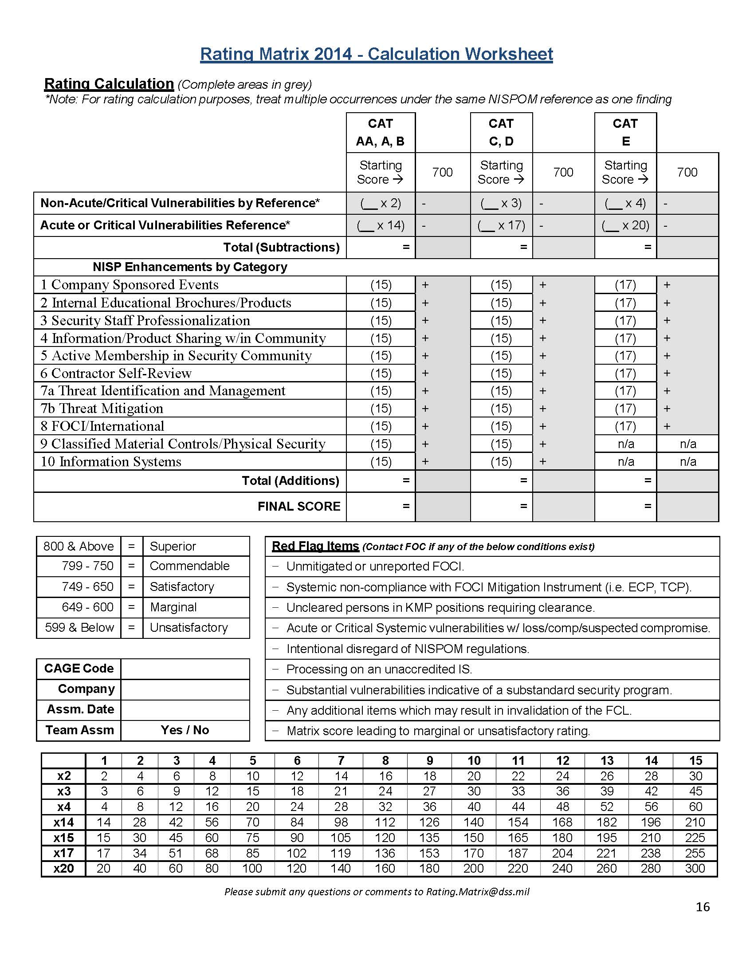

Slide 5
Vulnerabilities
If a contractor is not in compliance with the requirements of the nispom, they can be issued:
Acute Vulnerability* (imminent risk of loss/compromise of classified material)
Critical Vulnerability* (serious non-compliance which may result in loss/compromise of classified material)
Vulnerability (non-compliance which are not considered acute or critical)

Slide 6
Vulnerabilities (cont’d)
Acute and critical vulnerabilities can be further categorized as:
Isolated (single occurrence)
Systemic (deficiency demonstrating defects in a specific subset of the security program, such as lack of security education, maintaining JPAS records, etc.)
Repeat (specific occurrences noted in the last SVA which were not corrected in the subsequent SVA)
Note: All vulnerabilities identified by DSS will be documented, counted, and points subtracted from the Rating Matrix including those “Corrected on the Spot” (COS).

Slide 7
Enhancements!
An enhancement directly relates to and enhances the protection of classified information beyond baseline NISPOM standards.
In order for an enhancement to be granted, the facility must meet the baseline NISPOM requirements in that area (no acute or critical vulnerabilities).
The enhancement must be validated at the SVA – usually thru cleared employee interviews.

Slide 8
Enhancements!
Don’t get confused between “Best Practices” and “NISP Enhancements”!
Best Practices are typically where a NISPOM requirement is expanded on or conveyed in unique way but resulting in the same end goal (i.e., adding questions to your annual security briefing is a Best Practice).
Enhancement is something above and beyond what is expected of the facility based on NISPOM requirements (i.e., establishing a monthly newsletter with security updates used company-wide)

Slide 9
10 Categories of Enhancements
1. Company sponsored events
2. Internal educational brochures
3. Security staff professionalization
4. Information/product sharing
5. Active membership in security community
6. Contractor self-inspection
7a. Threat identification & management
7b. Threat mitigation
8. Foci/international
9. Classified material controls/physical security
10. Information systems

Slide 10
Enhancement defined: In addition to the annual required security refresher briefings, the cleared contractor holds company sponsored events to promote security awareness among the employees or the community. Intent of this category is to encourage cleared contractors to actively set time aside highlighting security awareness and education. This should not be a distribution of a paper or email briefing, but rather some type of interactive, in-person activity.
Enhancement Ideas:
Hold company sponsored events such as security fairs, interactive designated security focused weeks, security lunch events;
Bring in guest speakers (DSS, FBI, etc.) to your company on security related topics;
Hold security webinar with company employees;
Conduct training events at customer locations.
Bring in Government presentations pertaining to its NISP involvement (DSS, NCIS, ISOO, etc.);
Arrange for your cleared employees to attend additional security training events at customer or other contractor locations;
Conduct training company-wide on topics like ITAR, PII, Cyber Security, Active Shooter training, etc.;
Host an IAC meeting or provide sponsorship for an IAC event.

Slide 11
Enhancement defined: A security education and awareness program that provides enhanced security education courses or products to employees beyond initial and annual refresher training requirements; i.e., CD/DVD, web based interactive tools, newsletters, security games/contests, international security alert system, etc. Intent of this category is to encourage cleared contractors to generate and distribute relevant security materials to employees who then incorporate the content into their activities
Enhancement Ideas:
Provide your cleared personnel with security-related products such as webinars, newsletters, security games/contests, etc. (Home office can flow down security-related products to Branch offices and the Branch office can receive Enhancement points as long as the cleared employees of that Branch incorporate the information into their security awareness.
Distribute relevant security education information provided by Government activities (DSS, FBI, etc.) to incorporate into your security program. Key is to “incorporate” and not simply email out briefings passed on to your facility.
Provide security education to uncleared employees that addresses the company’s facility clearance level and its effect on all employees of the company;
Suspicious contact reports, adverse information reports, how to recognize classified material that is unprotected and how to report these findings, etc.;
Develop an ongoing CI and/or cybersecurity awareness program for all employees (cleared & uncleared) focused on specific threats to contractor facility’s classified programs. Validate thru training material and employee interviews.

Slide 12
Enhancement defined: Security staff training exceeds NISPOM and DSS requirements and incorporates that knowledge into NISP administration. Intent of this category is to encourage security program’s key personnel to actively strive to learn more and further their professional security expertise beyond mandatory requirements.
Enhancement Ideas:
Obtaining and maintaining professional certifications such as Certified Protection Professional (CPP), SPeD Certification, Computer Information Systems Security Professional (CISSP), Security Plus, etc.
http://www.cdse.edu/certification/sped_what.html#
http://www.cdse.edu/toolkits/insider/awareness.html
Partial completion of a training program (beyond base training requirements per NISPOM 3-102 and 8-101b) if accomplished security relevant courses applicable to one’s duties. (i.e., final training certificate is not a requirement to receive credit).
Additional CDSE courses, STEPP courses, NCMS “brown bag” training sessions; other training offered by IACs or other security organizations
AFSOs and other security assistants complete the FSO coursework

Slide 13
Enhancement defined: Facility Security Officer (FSO) provides peer training support within the security community and/or shares security products/services with other cleared contractors outside their corporate family. Intent of this category is to encourage cleared contractors to actively reach out to other cleared contractors to assist those who may not have the expertise or budget and provide them with security products, services, etc.
Enhancement Ideas:
Sharing classified destruction equipment to the local security community. Classified should be properly handled, i.e. per NISPOM requirements.
Cleared contractor actively participates in DSS pilot programs and other services and products.
Cleared contractor shares examples of effective self-review methods. (Multiple Self Reviews = Enhancements!)
Cleared contractor provides training and support for new facilities. For example: Electronic Facility Clearance (eFCL), JPAS, Electronic Questionnaire for Investigations Processing (eQIP), etc.
Cleared contractor assists other cleared contractors with international activities such as writing of Technology Control Plans (TCP), Transportation Plans (TP), etc.
Information Systems Security Manager (ISSM) or Facility Security Officer mentors ISSMs/FSOs at other cleared contractors.
Mentorship!

Slide 14
Enhancement defined: Security personnel are members and actively participate with NISP/security-related professional organizations. Intent of this category is to encourage security programs to actively collaborate with their local security community to identify best practices to implement within their own NISP security programs.
Enhancement Ideas:
Examples of these types of organizations include security/NISP-related activities.
Cleared contractor hosts security events on behalf of security/NISP-related professional organizations.
Cleared contractor security staff is a guest speaker at a security event provided by a security-related professional organization.
Members of the facility’s security staff are elected on security community boards (i.e. President or Committee/Board Member).
Special Committees (security events, sponsorship of training aids where committee is formed for development, hosting monthly “lunch-n-learns”)

Slide 15
Enhancement defined: Contractors sustain a thorough, impactful review of their security posture. Intent of this category is to encourage cleared contractors to maintain an effective, on-going self-review program to analyze and identify any threats or vulnerabilities within their program and coordinate with DSS to address those issues prior to the annual assessment.
Enhancement Ideas:
Cleared contractor provides DSS a detailed report of their self- review to include identified threats or vulnerabilities, analysis, and countermeasures to mitigate vulnerabilities, and collaborates with DSS to correct prior to the annual assessment.
Multiple documented self-reviews providing an on-going, continuous evaluation of the security program.
Establishment of internal corporate review program conducted by another facility within the organizational/corporate structure in addition to the required self-review.
Self-review conducted by a cleared contractor outside of the corporate structure, i.e. prime contractor assisting a subcontractor or a consultant with an applicable need-to-know (DD254).

Slide 16
Enhancement defined: The foreign intelligence threat to cleared contractors is constant and pervasive. The intent of this enhancement is to encourage cleared contractors to build a counterintelligence (CI) focused culture, implementing strategies and processes within their security program to detect, deter, and expeditiously report suspicious contacts (SCR) to DSS. By way of this enhancement, DSS encourages cleared contractors to develop programs, policies, and processes that identify and proactively thwart foreign attempts across known threat vectors (purchase solicitation, foreign visit and foreign travel, suspicious network activity, academic solicitation, etc.) to acquire classified and sensitive technologies. Effective threat management and mitigation includes timely identification and reporting of suspicious activities, an understanding the threat environment, agile and authoritative decision making to neutralize or mitigate vulnerabilities and threats, and proactive action to prevent any reoccurrence of a reported
Enhancement Ideas:
Systematic and effective foreign travel /contact pre-briefings and de-briefings conducted in-person or telephonically designed to identify contacts or activities displaying potential espionage indicators.
Systematic notification process advising DSS of incoming and outgoing foreign visitors prior to occurrence and implementation of briefing and debriefing program for persons hosting foreign visitors.
Implementation of an effective Insider Threat program designed to identify insider(s) that uses his/her authorized access, wittingly or unwittingly, to do harm to the security of the United States. This threat can include damage to the United States through espionage, terrorism, unauthorized disclosure of national security information, or through the loss, denial or degradation of departmental resources or capabilities. (This enhancement will not be awarded with the issuance of Conforming Change 2.)
Effective identification, collection, and coordination of threat information (pertaining to CI, cybersecurity, force protection, etc.) tailored to the facility’s classified programs or technologies, and application of related defensive measures. DEVELOP A CYBER PROGRAM TODAY!

Slide 17
Enhancement defined: As a result of the successful execution of Category 7a, Threat Identification and Management, cleared contractors (CC) who have validated vigorous and effective CI programs are more likely to identify foreign intelligence targeting of their technology. By way of this enhancement, DSS encourages CCs to directly engage with thwarting illegal attempts to acquire classified and sensitive technologies and support law enforcement and intelligence efforts to neutralize the threat. For this enhancement credit, the CC must have provided suspicious contact reporting to DSS resulting in the: • Initiation of investigations or activities by Other Government Agencies within the evaluation period. • Cleared facility must be awarded Category 7a enhancement, Threat Identification and Management, during the same assessment to qualify for this enhancement.
Enhancement Ideas:
An effective CI program that includes a federal law enforcement case opening linked to SCR reporting validated by DSS CI (Note: The date the OGA advises DSS of the investigation will be used as the validation date and falls within the assessment cycle).
An effective CI program that includes an intelligence community investigation linked to SCR reporting validated by DSS CI. (Note: The date the IC OGA advises DSS of the investigation will be used as the validation date and falls within the assessment cycle).
An effective CI program that includes essential and critical cooperation provided to federal law enforcement or intelligence community agencies pursuing the neutralization of illegal penetrators validated by the investigative agency.
An effective CI program that includes an intelligence or federal law enforcement case opening linked to contractor facility’s identification of suspicious network activity, anomalies or intrusions of CC systems to DSS.

Slide 18
Enhancement defined: Cleared contractor implements additional effective procedures to mitigate risk to export controlled items and/or FOCI. Intent of this category is to encourage cleared contractors to implement an enhanced export control program increasing the effectiveness. For FOCI mitigated facilities, intent is to encourage activities above mitigation instrument requirements to further minimize foreign influence at the facility.
Enhancement Ideas:
Note - Items which are requirements of the mitigation instrument may not be counted as enhancements.
Cleared contractor performs significant trend analysis of internal governance processes and interactions with the foreign parent company and affiliates. Contractor uses this trend analysis and follow-on audit programs to proactively identify and report attempts of undue influence to DSS, to identify weaknesses and best practices.
Facility voluntarily conducts, or has outside experts conduct, ongoing export compliance audit and shares the results with interested U.S. Government Agencies.
Facility maintains an enhanced ongoing export control self-inspection program.
Effective briefing and debriefing program for persons hosting foreign visitors.
Enhanced TCP processes would include cleared contractors developing a Foreign Visitor management system to include foreign national visitors being approved by export control and security before arrival. Security briefs for all FN visitors on the TCP and guards are required to have a foreign visitor request approval number before the FN can enter the facility (being escorted by an appropriately briefed individual).
100% or a risk-prioritized review of electronic communications with documented action-driving analysis with a documented follow-on audit/interview program, including enterprise-wide analysis for anomalies.
Outside Directors, Proxy Holders, or Trustees interacts directly with the cleared contractor site employees (training program, vulnerability assessment, compliance visits, etc.) with effective impacts.
Requiring that all electronic communications to the parent or affiliates obtain advance approval.
Implements and maintains system for automatic designation of emails to/from foreign parent/affiliates.
Appointment of additional Outside Directors, Proxy Holders, or Trustees. The facility must demonstrate the benefit in additional FOCI oversight these persons add (i.e. OD is assigned specifically to monitor and report on X).

Slide 19
Enhancement defined: Facility has deployed an enhanced process for managing classified information and/or has implemented additional Physical Security measures, with built-in features to identify anomalies. Intent of this category is to encourage security programs to maximize the protection and accountability of classified material on-site by implementing effective processes, regardless of quantity of classified holdings.
Enhancement Ideas:
Information Management System (electronic or physical) reflects history of location and disposition for material in the facility for Secret and Confidential material (100% inventory and accountability, paralleling requirements for Top Secret).
Working papers are fully marked and automatically brought into IMS regardless of date of creation.
Safe custodian performs 100% check-in/check-out of materials, reviews material for appropriate markings and classification. DO THIS MULTIPLE TIMES.
Monitored and recorded CCTV, card access readers, biometric equipment strategically positioned around controlled areas with on-going analysis of data.
In addition to supplemental control requirements, facility has written procedures outlining guard personnel responsibilities to include verifying safes, closed areas, etc. are properly secured and/or verifying working areas are free of classified information and maintain documentation of performance.

Slide 20
Enhancement defined: Incorporating process enhancements and leveraging tools to expand the overall security posture of accredited information systems. Intent of this category is to encourage security programs to maximize protection of classified information on IS.
Enhancement Ideas:
Development and use of a formalized SOP and a comprehensive checklist to augment a detailed weekly audit review process which describes what is performed during the review of large, complex IS (LANs/WANs) with multiple Operating Systems.
Additional IS oversight processes put in place to enhance security of classified information residing on IS.
Develop, implement, and utilize significant and effective (LAN/WAN based) Information System audit trail reduction/collection or analysis tools/scripts. These tools help focus on real security relevant events while minimizing the amount of non-security relevant data extracted within the audits.
Use of a file or scripts that tracks downloaded files and/or compares generation records for unauthorized classified downloads and review/auditing of report outputs.
Use of a file or scripts that tracks and/or block unauthorized USB connections and review/auditing of report outputs.
Utilize scripts to maintain compliance to the SSP and ODAA's baseline. The scripts validate Security Relevant Object (SRO) settings and report back if discrepancies are found. ISSM reviews and acts on report findings.

Slide 21
Recap
Go Above & Beyond
Start with “low hanging fruit”
Start your own Cyber Security Awareness group
Take advantage of training opportunities
Limit your vulnerabilities
Develop & maintain a GREAT rapport with you DSS reps
Share ideas or mentor others
Become involved in IAC groups
Be Proactive…not Reactive
Conduct reviews throughout the year
Stay current in your field

Slide 22
Questions?

